Slide 1
Airbus Ship Detection
Team: | He Li (heli@bu.edu)
 | Ruxin Diao (ruxin@bu.edu)
GitHub: | https://github.com/helibu/Airbus-ship-detection
Trello: | https://trello.com/b/OI51Ynv6/airbus-ship-recongization

Slide 2
CONTENTS
Background
User stories
Previous Products
Diagram of the product
Project assignment for every member
Sprint plan
Trello page

Slide 3
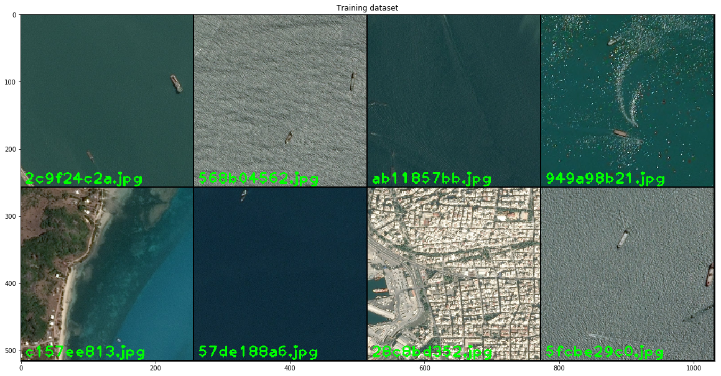
Background
Number of ships keep growing
To detect ships from satellite images to monitor ships
Example pics from the Training Data:

Slide 4
Background
Why we want to detect ships?
Disaster Response
Oil Spill Detection, pollution detection
Marine transportation optimization
Supervise the coastlines for security threats and illegal activities
Source: “An information system for ship detection and identification. IEEE”

Slide 5
User Stories
As a Market Trader, I can track marine traffic to forecast commodity prices.
As a transportation company, we can optimize the route to improve the efficiency.
As port authorities, we can manage marine traffic to ensure safety. When the disaster comes, this kind of service can assure a quick response and full supervision of the ships.
As environment authorities, oil spill detection and pollution detection can be much easier.
As a Marian police, I find it very convenient to supervise the coastlines for security threats and illegal activities
Source: “An information system for ship detection and identification. IEEE”

Slide 6
Previous Products
Previous Products:
acoustic underwater
electric field detector
ship based coastal radar.
This product:
satellite imagery
Source: “An information system for ship detection and identification. IEEE”

Slide 7

Diagram of the product
Dataset
User Input image/dataset
Cloud (AWS)
Test data validate
Web page
Windows app
Web server (AWS)
TensorFlow
Training model
Cross validation
Applications
Model develop and optimize
Output the numbers and locations of ships
Notes:
The U-Net is a convolutional neural network for segments and classification. U-shaped architecture.
VGG16 is deep convolutional network for object recognition developed and trained by Oxford's renowned Visual Geometry Group. Very Deep Convolutional Networks for Large-Scale Image Recognition
ResNet is a residual learning framework, Residual neural networks do this by utilizing skip connections or short-cuts to jump over some layers

Slide 8
Diagram of the product
User Input images
Full Dataset
Ship Existence Model
Web server (AWS)
Web page
Dataset
No ship
Has ship
Segmentation Model
Ships locations
Output detected ships with box
Dataset with Ships
Machine Learning Models
Applications
Notes:
The U-Net is a convolutional neural network for segments and classification. U-shaped architecture.
VGG16 is deep convolutional network for object recognition developed and trained by Oxford's renowned Visual Geometry Group. Very Deep Convolutional Networks for Large-Scale Image Recognition
ResNet is a residual learning framework, Residual neural networks do this by utilizing skip connections or short-cuts to jump over some layers

Slide 9
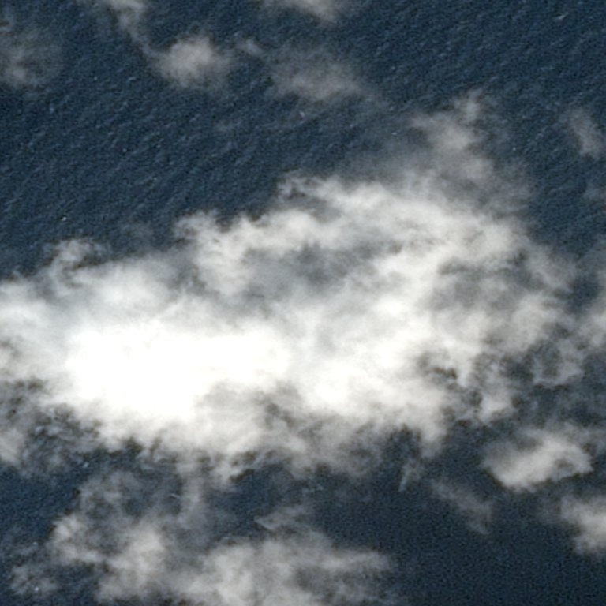
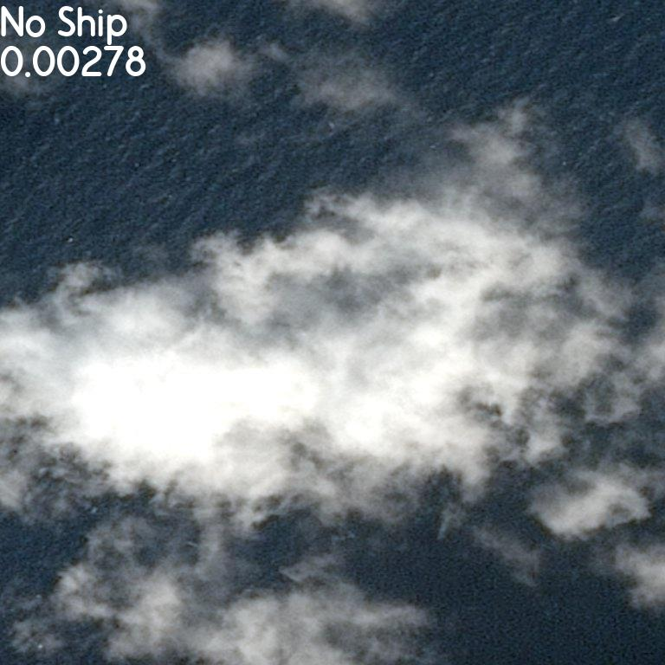
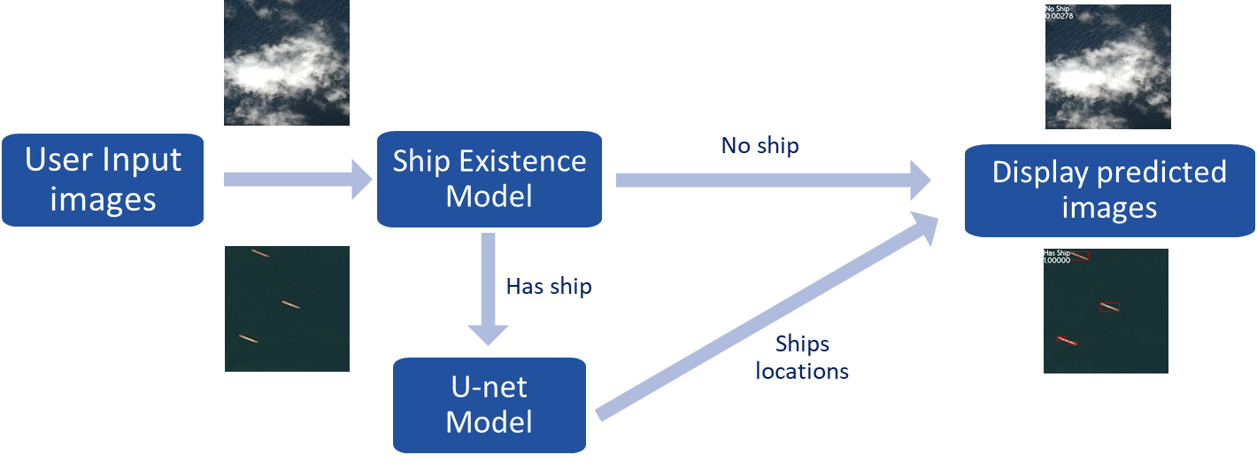
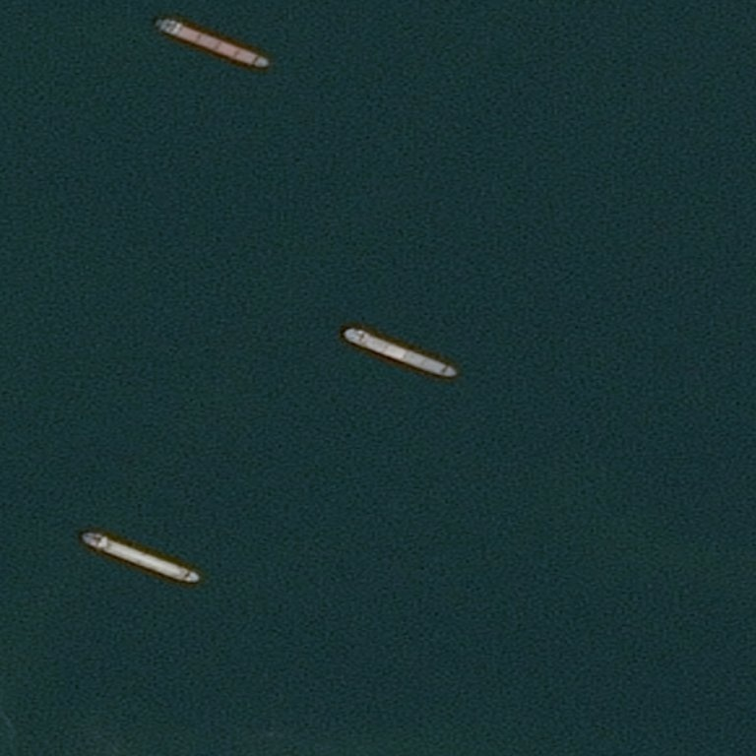
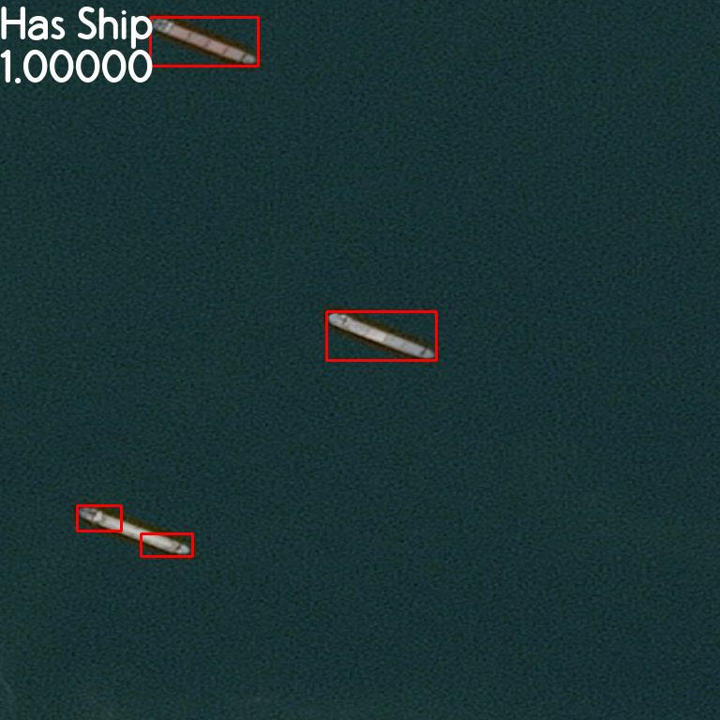
Diagram of the product
User Input images
Ship Existence Model
No ship
Display predicted images
Has ship
Ships locations
U-net Model
Machine Learning Models
Applications
Notes:
The U-Net is a convolutional neural network for segments and classification. U-shaped architecture.
VGG16 is deep convolutional network for object recognition developed and trained by Oxford's renowned Visual Geometry Group. Very Deep Convolutional Networks for Large-Scale Image Recognition
ResNet is a residual learning framework, Residual neural networks do this by utilizing skip connections or short-cuts to jump over some layers

Slide 10
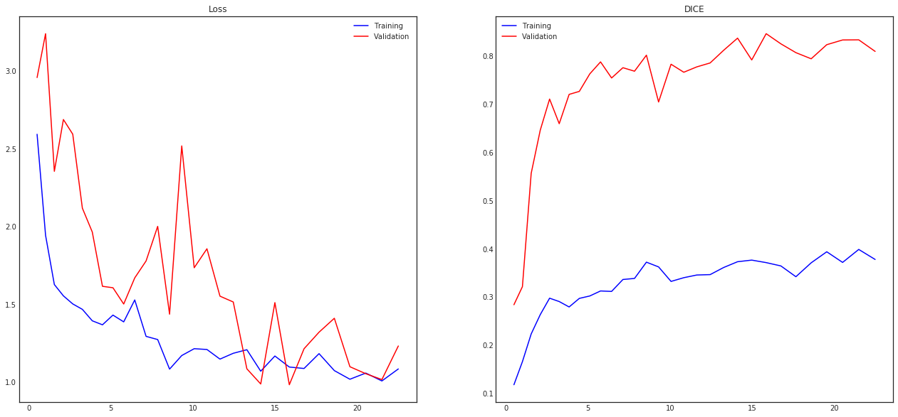
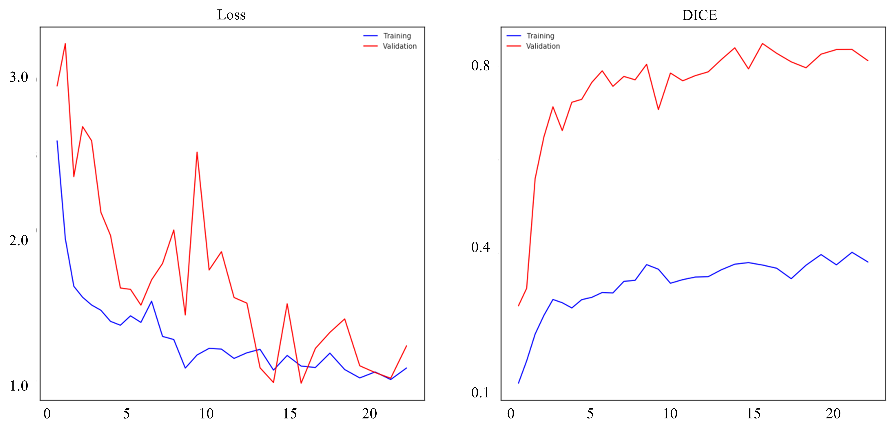
Diagram of the product
Loss
DICE
0.8
0.4
0.1
3.0
2.0
1.0
User Input images
Ship Existence Model
No ship
Display predicted images
Has ship
Ships locations
U-net Model
Machine Learning Models
Applications
0 5 10 15 20
0 5 10 15 20
Notes:
The U-Net is a convolutional neural network for segments and classification. U-shaped architecture.
VGG16 is deep convolutional network for object recognition developed and trained by Oxford's renowned Visual Geometry Group. Very Deep Convolutional Networks for Large-Scale Image Recognition
ResNet is a residual learning framework, Residual neural networks do this by utilizing skip connections or short-cuts to jump over some layers

Slide 11
Diagram of the product
ResNet50
Dataset
Ensemble Model
Ship Existence Model
Full Dataset to train
Combine
VGG16
Web server (AWS)
Web page
Full Dataset
User Input images
No ship
Has ship
Segmentation Model
Ships locations
Output detected ships with box
Dataset with Ships
Machine Learning Models
Machine Learning Models
Applications
Notes:
The U-Net is a convolutional neural network for segments and classification. U-shaped architecture.
VGG16 is deep convolutional network for object recognition developed and trained by Oxford's renowned Visual Geometry Group. Very Deep Convolutional Networks for Large-Scale Image Recognition
ResNet is a residual learning framework, Residual neural networks do this by utilizing skip connections or short-cuts to jump over some layers

Slide 12
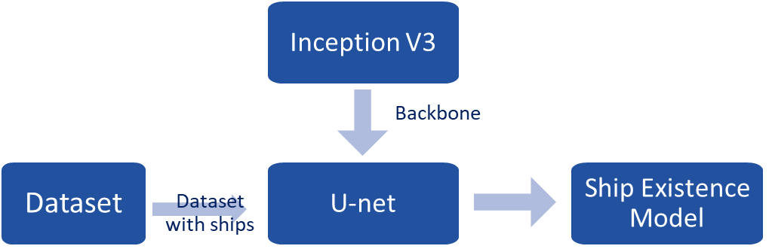
Diagram of the product
Inception V3
Backbone
Dataset
U-net
Ship Existence Model
Dataset with ships
Notes:
The U-Net is a convolutional neural network for segments and classification. U-shaped architecture.
VGG16 is deep convolutional network for object recognition developed and trained by Oxford's renowned Visual Geometry Group. Very Deep Convolutional Networks for Large-Scale Image Recognition
ResNet is a residual learning framework, Residual neural networks do this by utilizing skip connections or short-cuts to jump over some layers

Slide 13


Cloud platform
Deep learning computing (AWS deep learning AMIs)
Web Server (AWS EC2)

Slide 14


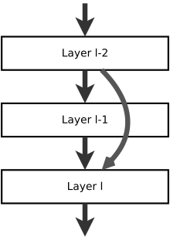
Deep learning architecture
TensorFlow
For Neural Network structure:
First, try basic CNN as baseline.
Then, advanced structure:
Different ways to organize the
relations between layers.
U-Net *
VGG16
ResNet

Slide 15
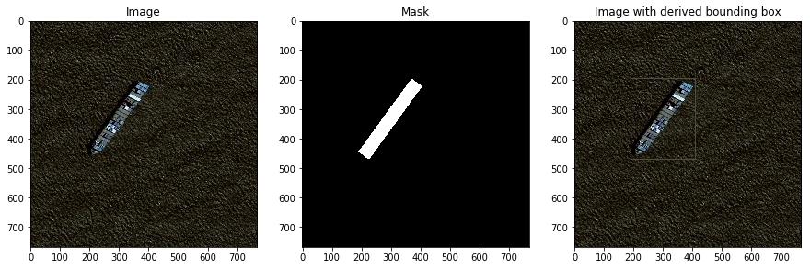
Minimum viable product
Algorithm can recognize ships and draw out ships in small deviation, even with noises like clouds and seashore. Of course, with high accuracy.
A web page which allows users to recognize ships from their satellite images.
A windows app can do the same thing, which can be easily operated be companies and government authorities.
Output pics are marked with detected ships and their location as below.

Slide 16
Project assignment for every member
He Li:
Data analyze, Data Visualization, Machine learning knowledge, CNN learning, model developing.
(python, TensorFlow, CNN, cloud computing)
Ruxin Diao:
Machine learning knowledge, Web design learning, Cloud/MapReduce implement, Windows app implement
(Html, CSS, JavaScript, C#, java, Tomcat server…)

Slide 17
Sprint plan 1
He Li: Dataset analyze, Dataset Visualization, Machine learning knowledge learning
Ruxin Diao: Machine learning knowledge learning, Web design learning

Slide 18
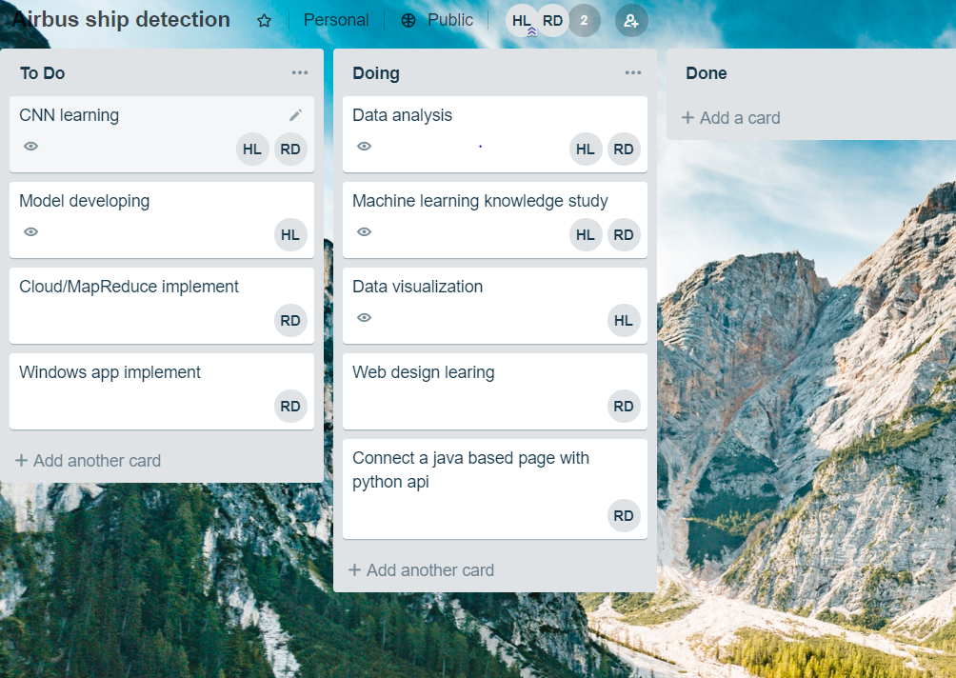
Trello Page

Slide 19
Thanks!

